Slide 1
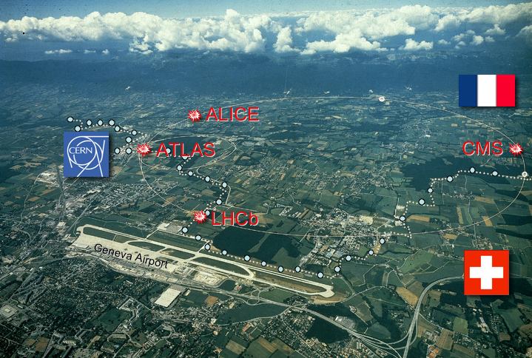

non-LHC program at CERN
LHC
Ewa Rondio
seminarium ZFWE
Warszawa, 20.04.2012

Slide 2
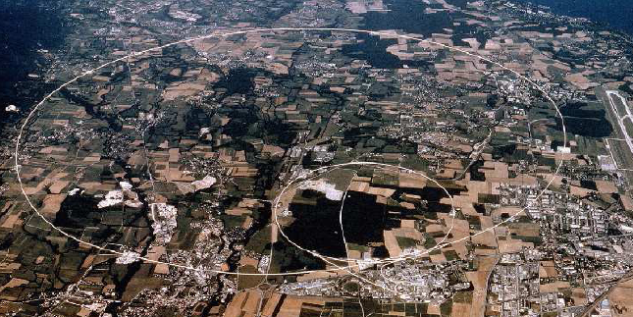
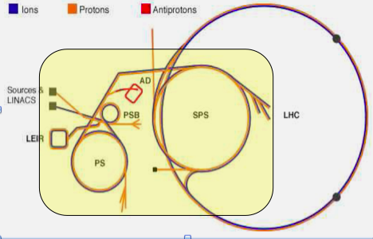
Accelerator complex at CERN
LHC injector system
protons with energy up to 450 GeV
→ this complex has it’s own reach
scientiffc program
,
Antiproton Decelerator
AD
linacs: protons and
ions, acceleration to 50 MeV
booster – up tp 1.4 GeV
SPS – Super Proton Synchrotron – 450 GeV
PS – proton synchrotron
up to 26 GeV

Slide 3
NON-LHC EXPERIMENTS @ CERN (cont.)
Antiproton Decelerator (AD)
4 running experiments (ATRAP,ASACUSA,ACE,ALPHA) and 1 in preparation (AEGIS)
newly approved exp. g-bar
all need ELENA decelerator to improve performance, preparation for construction
PS experiments
Dirac – ππ and πK atoms: life time, s-wave scattering length Lamb shift in proposal for >2011
CLOUD– facility to measure microphysical effects on aerosol nucleation in well controlled environment, start 2009
nToF experiments
– facility
class A target area for rad.samples
plan for second beam line
data with new target - started 2009
ISOLDE experiments
radioactive beams (29 elements)
above 20 targets
now Isolde and ReX-Isolde
approved HI-Isolde
non- accelerator experiments
CAST – search for axions from
the Sun, approved by 2011,
proposal for next generation
OSQUAR –restarted in 2010,
plans for few years data taking

Slide 4
NON-LHC EXPERIMENTS @ CERN
experiments at SPS
NA48→NA62 - CP violation in K-sector, rare K decays
next step K→πνν, detector construction, technical run - 2012
NA49→NA61 - heavy ions (analysis), now: data for neutrino production and cosmic ray shower simulation, pp - approved until 2011, secondary ion beams in 2011-2012, primary Ar beam
NA63 – strong field QED in crystals, bremsstrahlung with heavy ions in 2010
NA58- Compass – polarization
in nucleon, hadron spectroscopy,
until 2011
next step – Compass II
GPD from DVCS on proton,
DY on polarized target, Primakoff
UA9 – Crystal – channeling and
collimation by crystal, started 2009
CNGS neutrino beam (till 2012)
CNGS1 – Opera – search for
ν_{τ} in the neutrino beam from CERN
detection with nuclear emulsion
CNGS2 – Icarus – neutrino
interaction study with liquid argon TPC

Slide 5
Annual Progress Report of the Organization for the fifty-seventh financial year
The non-LHC physics programme was highly successful at all facilities - SPS, PS, AD, n_TOF, ISOLDE - and at the axion search experiments. The highlights include excellent physics runs by OPERA and ICARUS, with the former experiment’s measurement of the neutrino time-of-flight. Highlights also include the increased antihydrogen trapping efficiencies and storage times by ALPHA (published in Nature); the high-precision measurement of the antiproton mass by ASACUSA (published in Nature); the CLOUD analysis of aerosol nucleation under controlled conditions (published in Nature); the COMPASS muon run with a longitudinally-polarized proton target and the particle wave analysis of the 2008/2009 data set; the proton-proton high-pT studies at 160 GeV by NA61; and the completion of the RK analysis by NA62. For n_TOF, the intensity goals were reached for the first time, leading to a successful operation with several targets and providing results of interest to nuclear technology, medicine and astrophysics. A record number of shifts of radioactive beams were provided at ISOLDE and led to, among other notable results, the mass measurement of 82Zn. CAST completed their axion high-mass scan up to 1.15 eV/c².

Slide 6
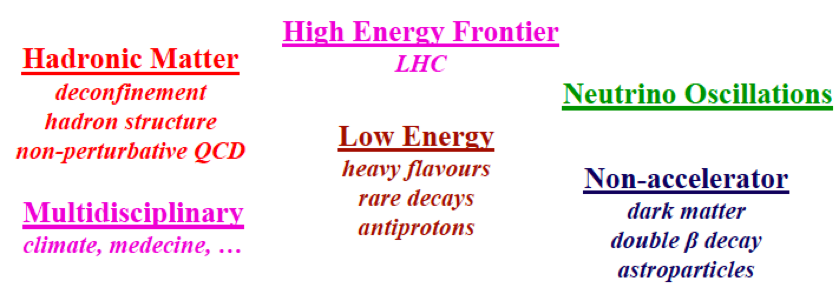
The particle physics landscape
at CERN
now and next 5-10 years
n-ToF
s-processes, cross sections,
fission, neutron-neutron int.
high brightness
ISOLDE
isotopes He to Ra
10⁻⁶eV – 3MeV/u
shell evolution, shapes,
exotic nucl.,tests of SM

Slide 7
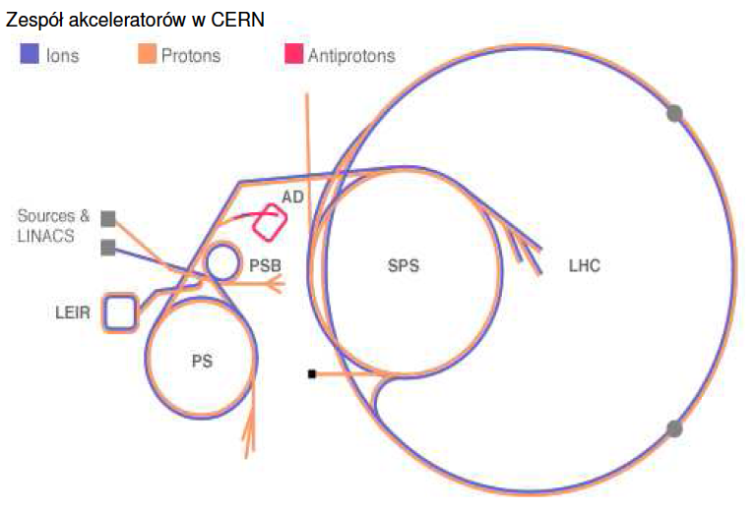
now we move to the lowest available energies: AD

Slide 8
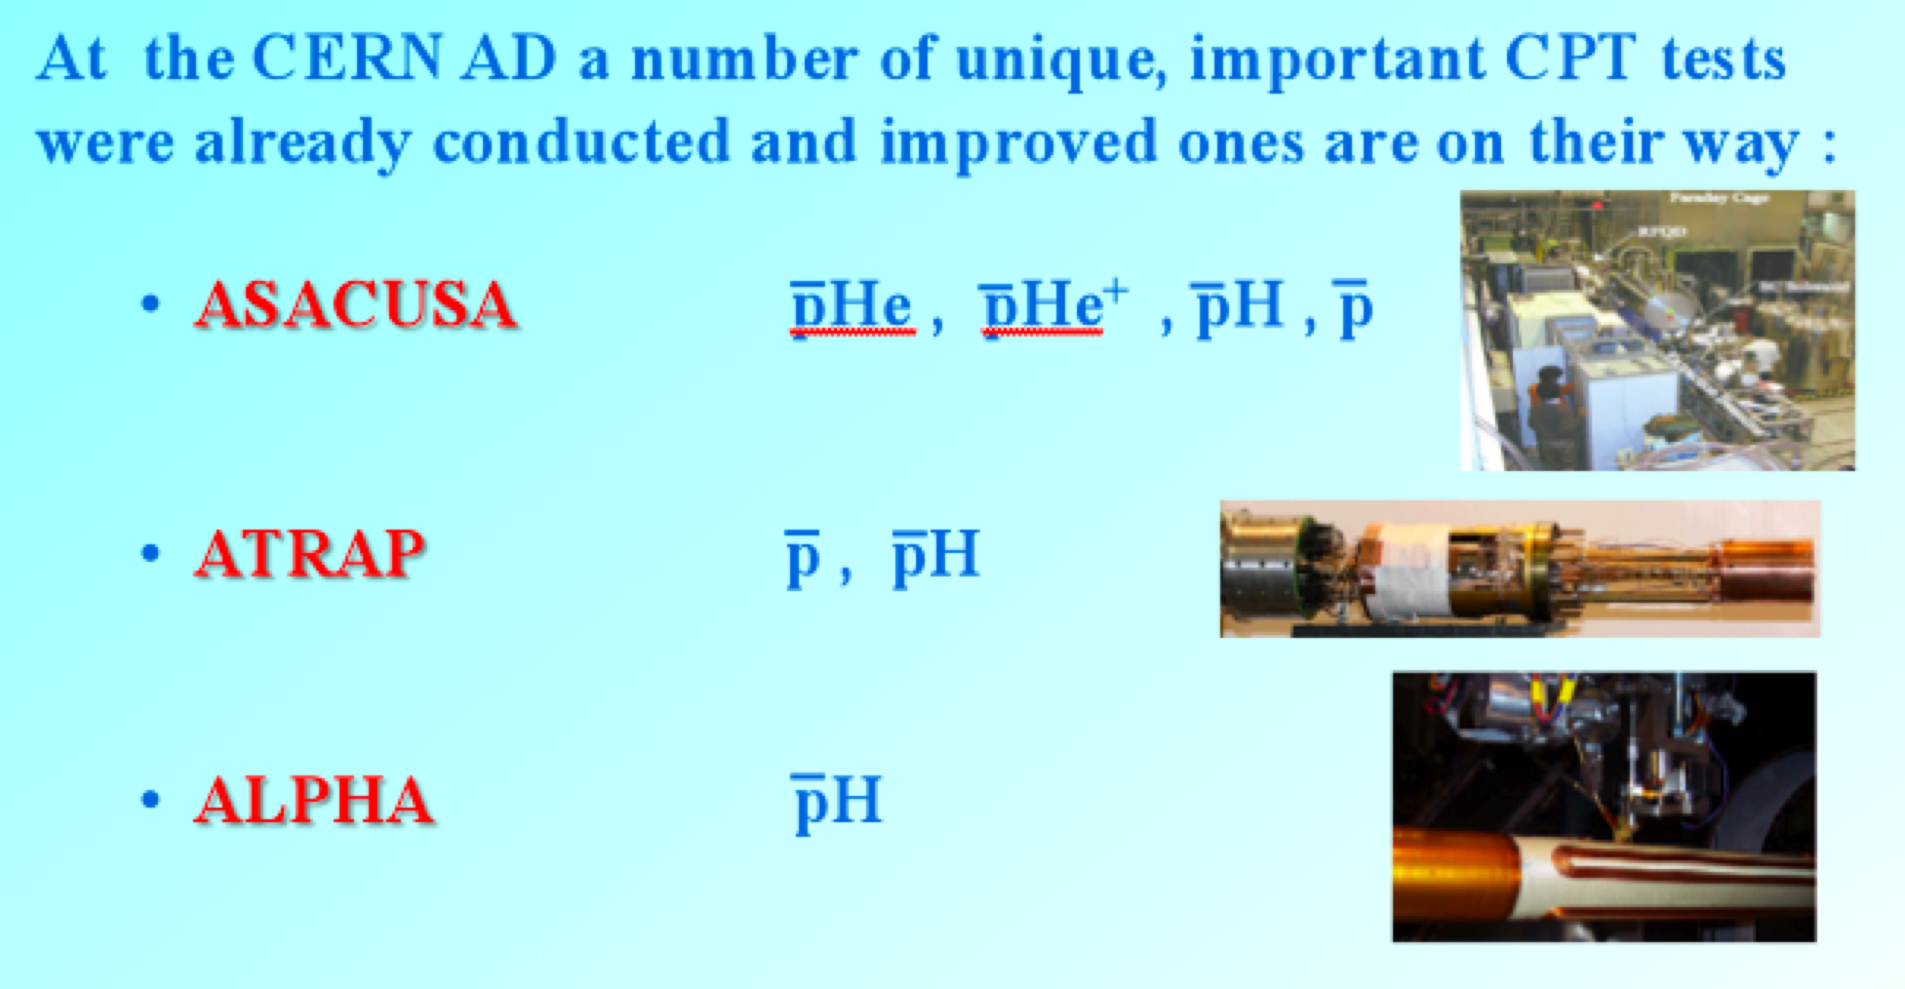
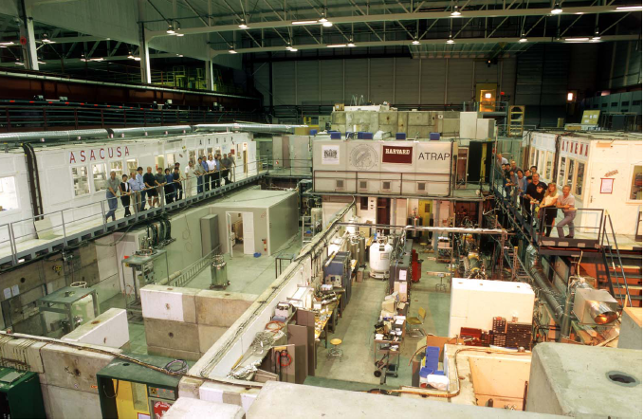
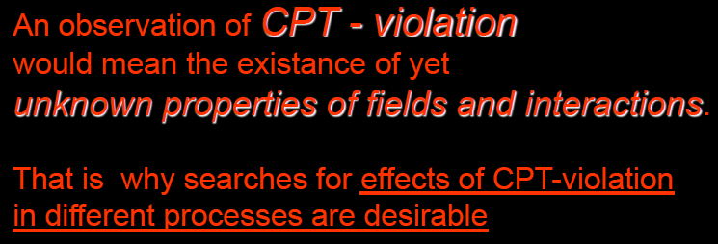
Antiproton decelerator (AD)

Slide 9
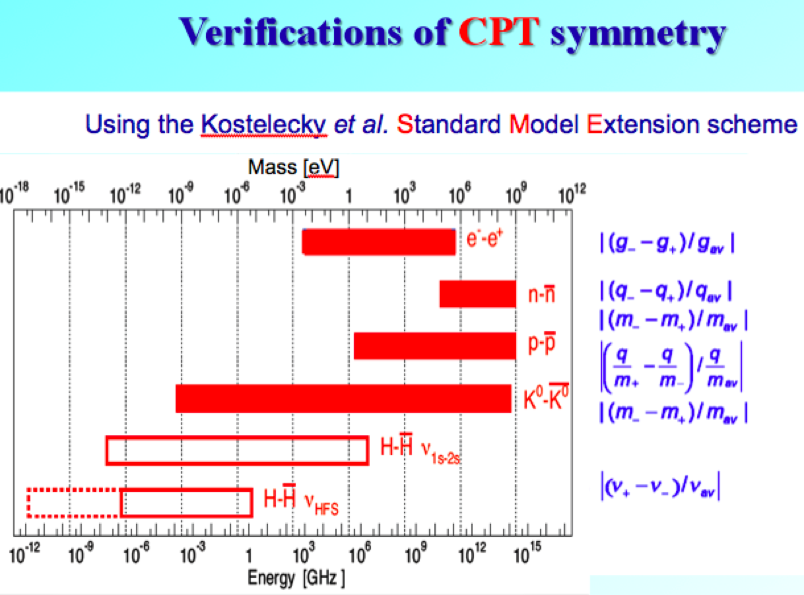
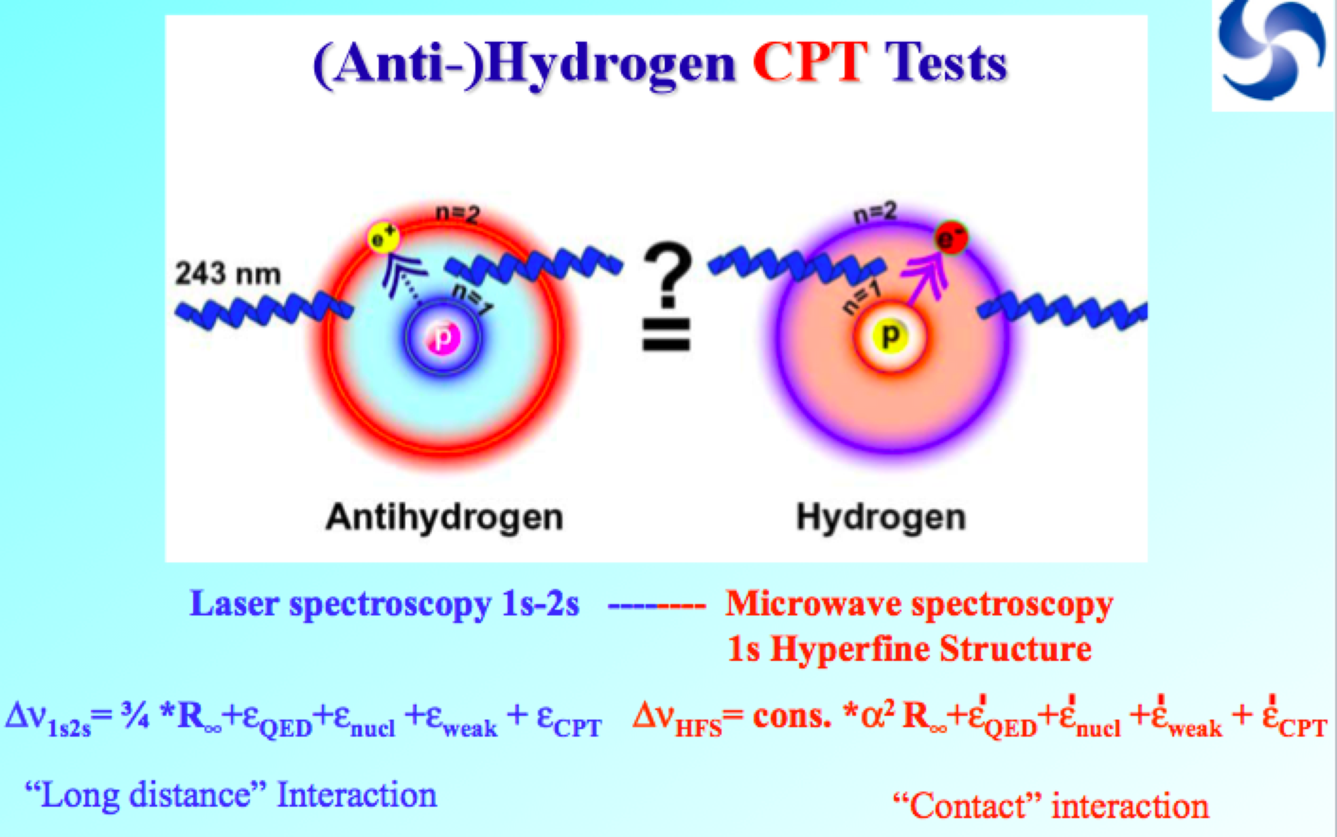
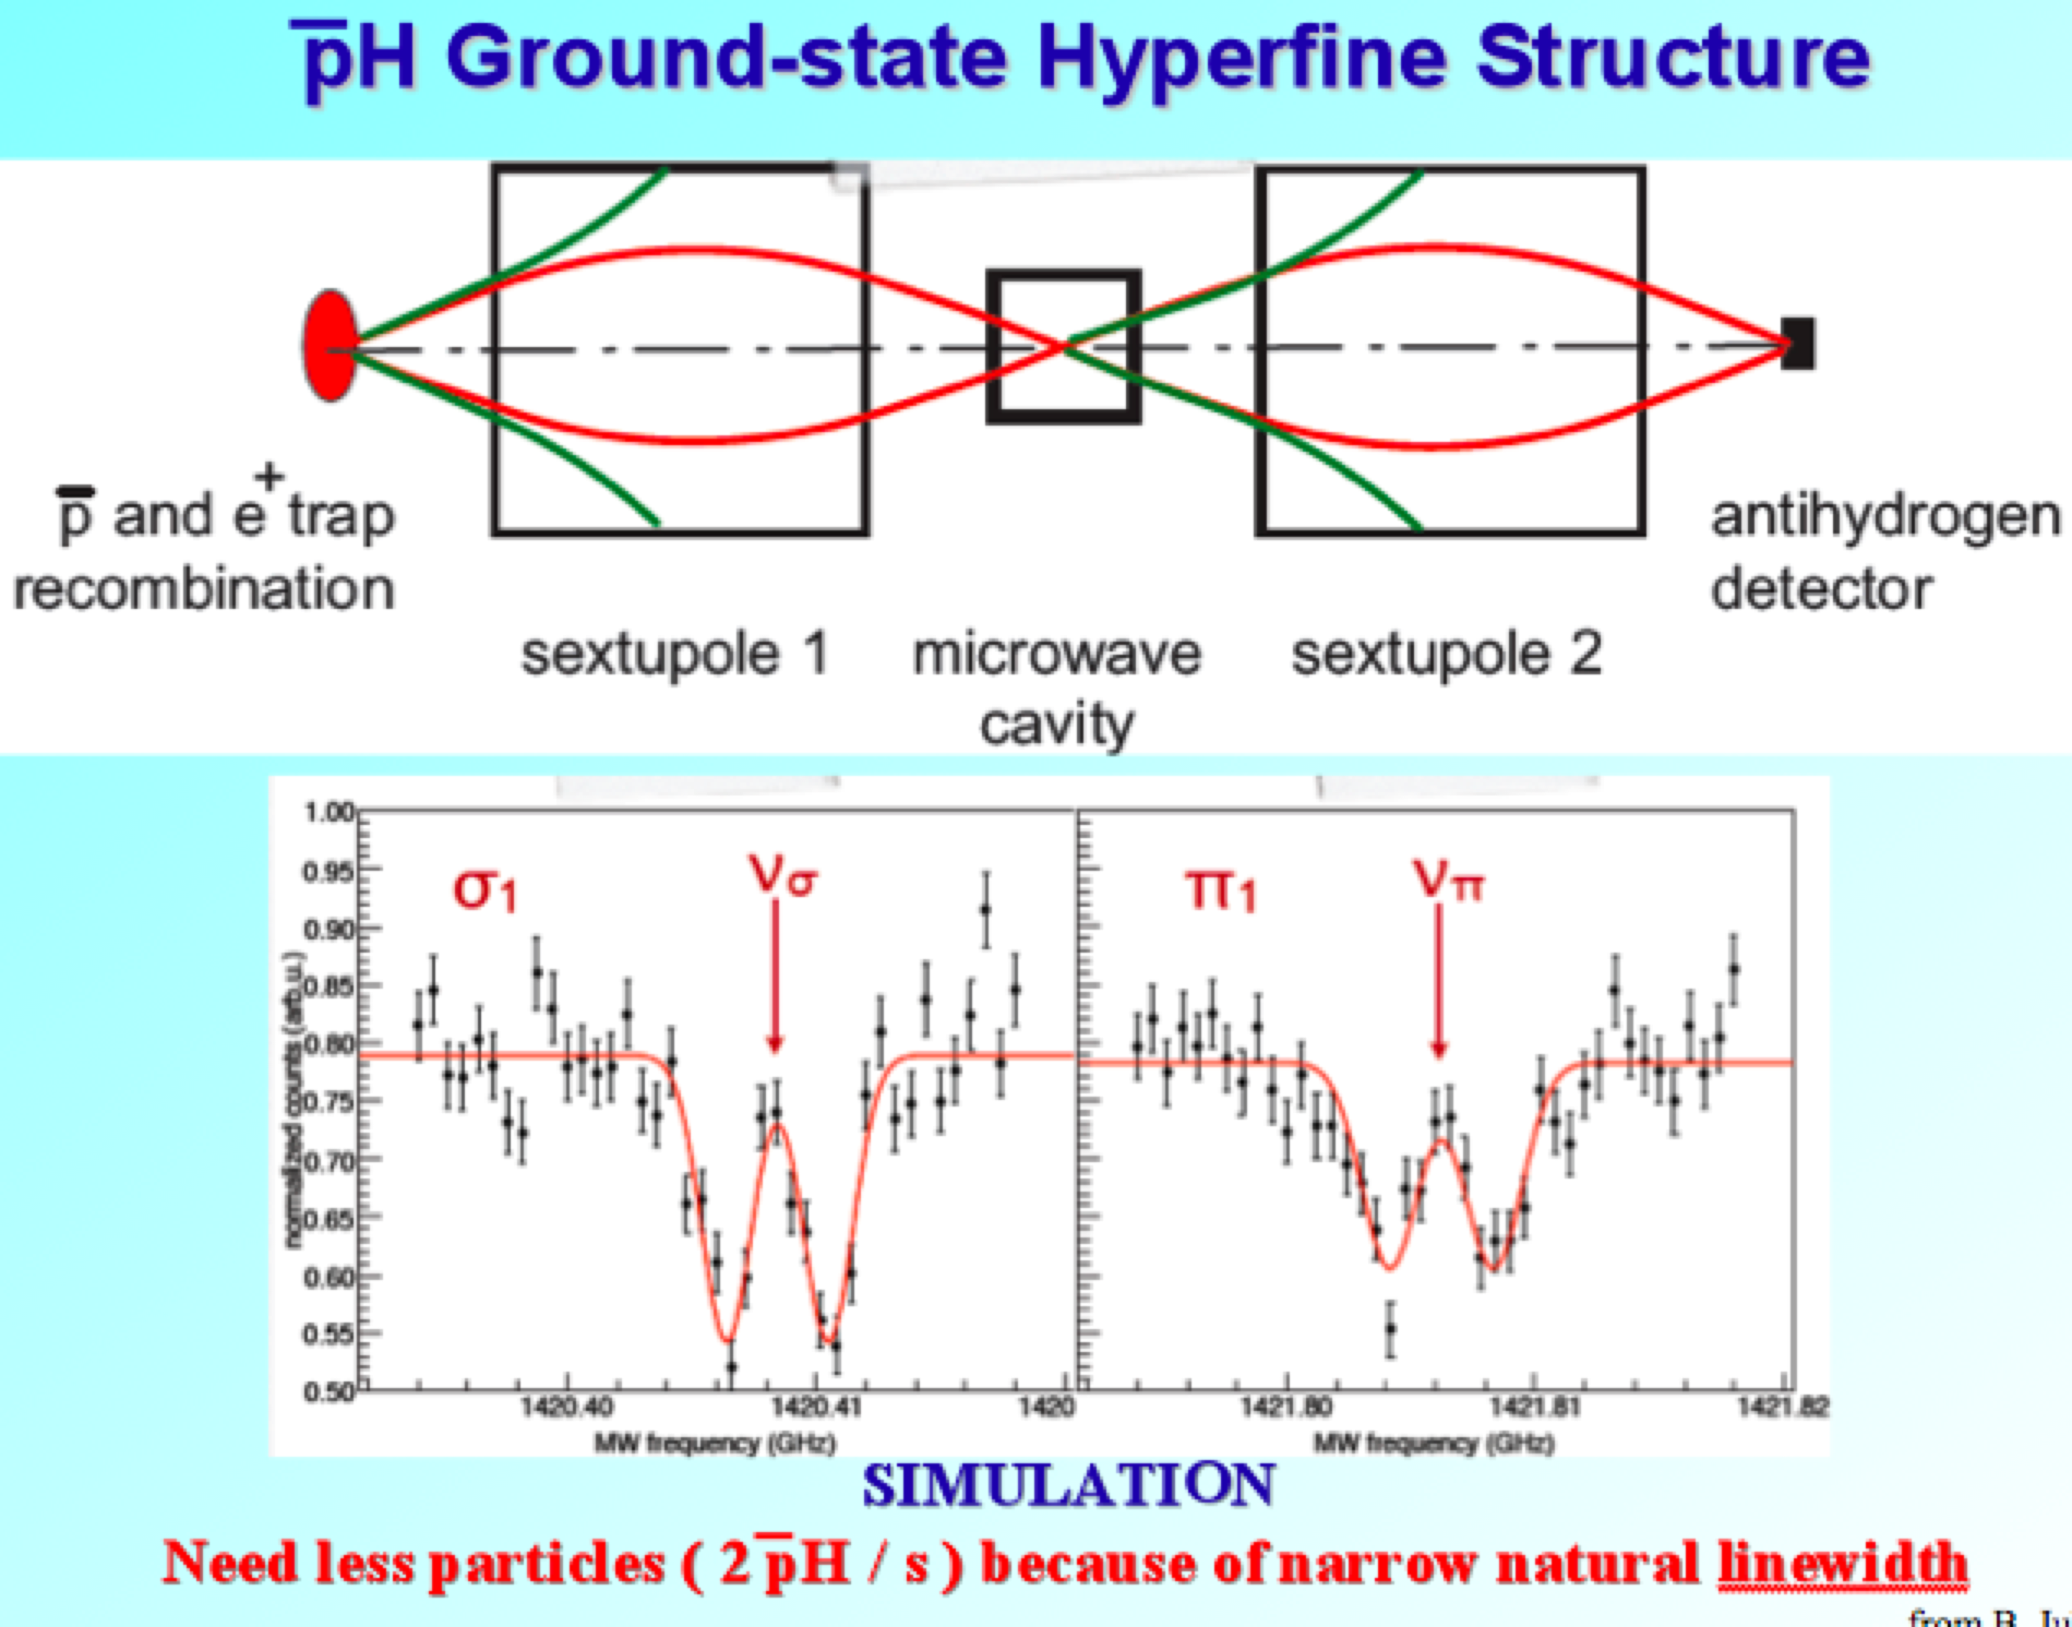
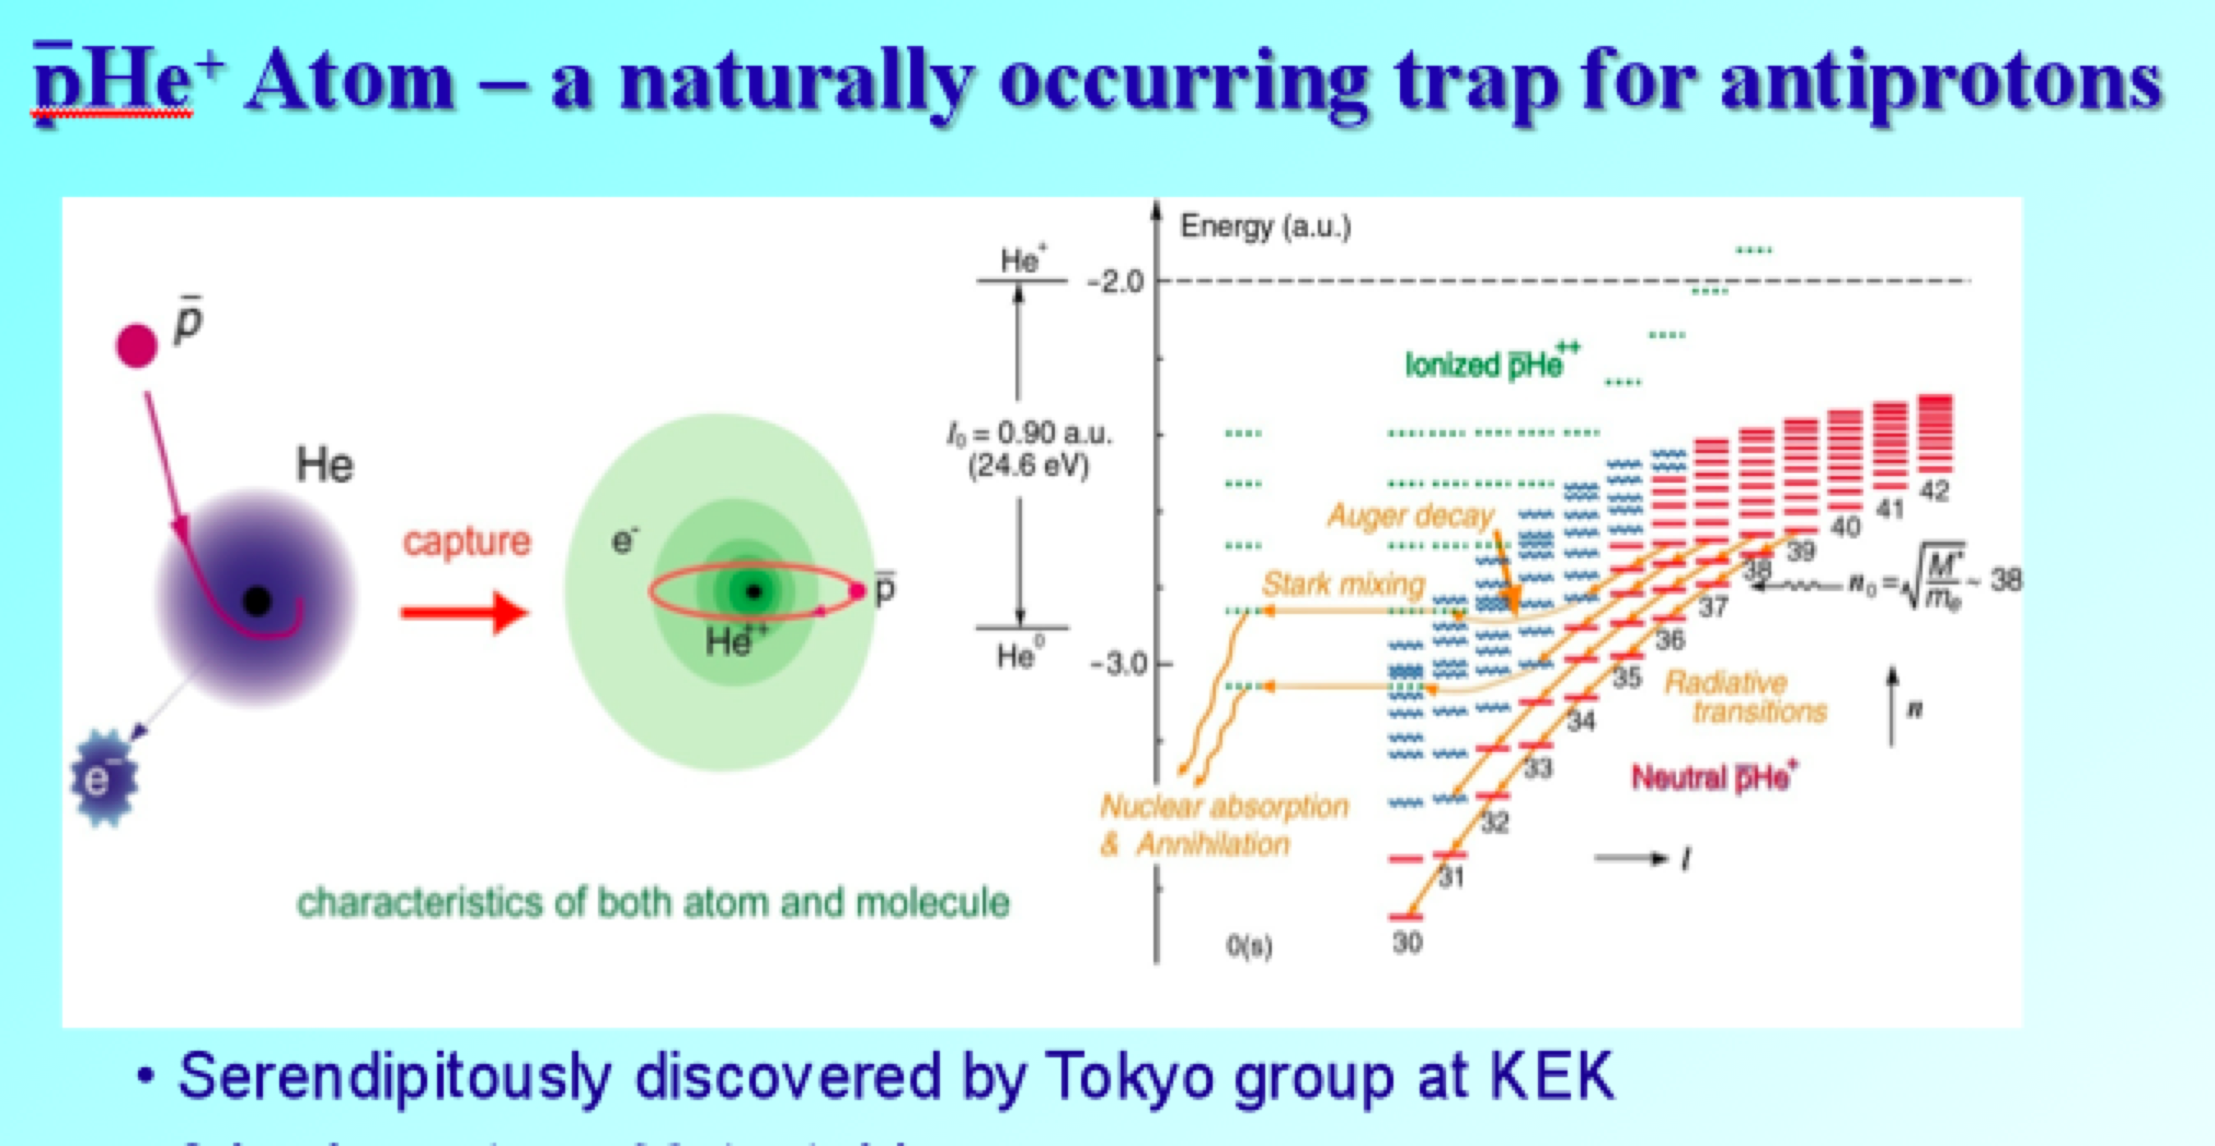
anti-protons experiments - program

Slide 10
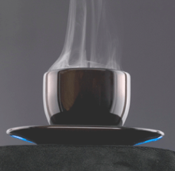
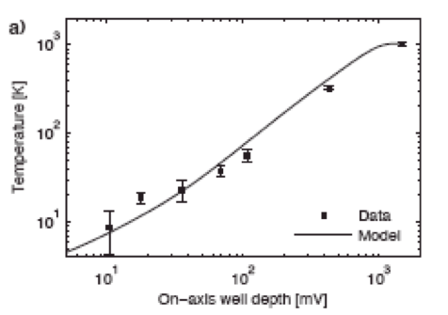
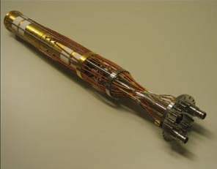
AD – antiproton decelerator
protons from PS produce antiprotons
they are cooled by evaporation
the fastest particle are lost, average energy goes down
→ obtained antiprotons temperature is 9 K
next step is to trap antiprotons
ALPHA
Penning trap

Slide 11
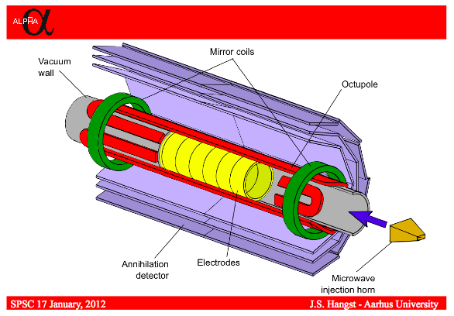
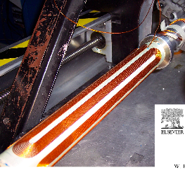
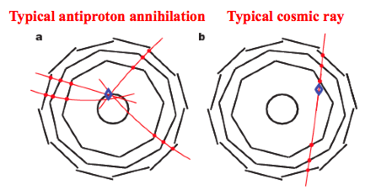
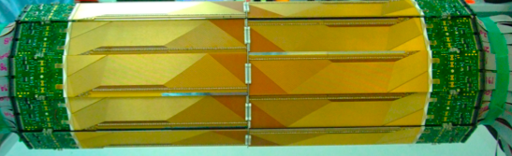

Slide 12
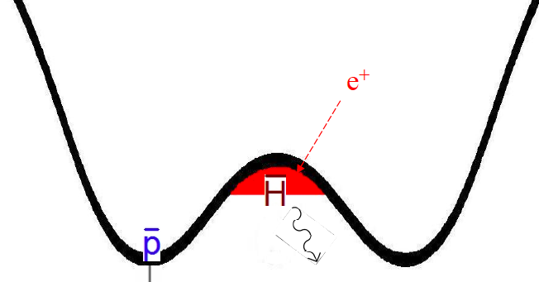
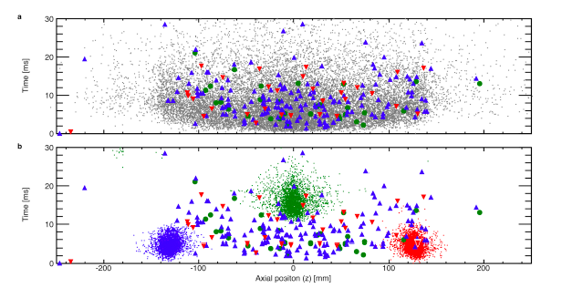
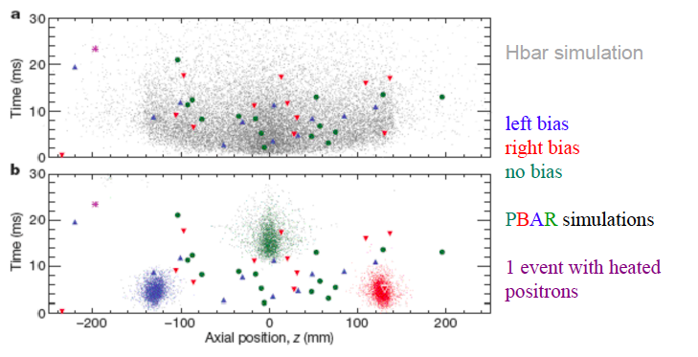
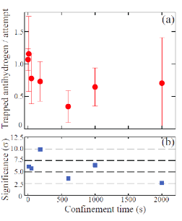
Trapping antihydrogen
→ Alpha and Asacusa
Physics Breakthrough award by Physics Word magazine,
Paper in Nature (2010)
Antihydrogen trapped at least 172 msec.
ALPHA
first data in 2011
trapping routinely (1 ev./trail)
time of trapping for 1000 sec. !!!

Slide 13
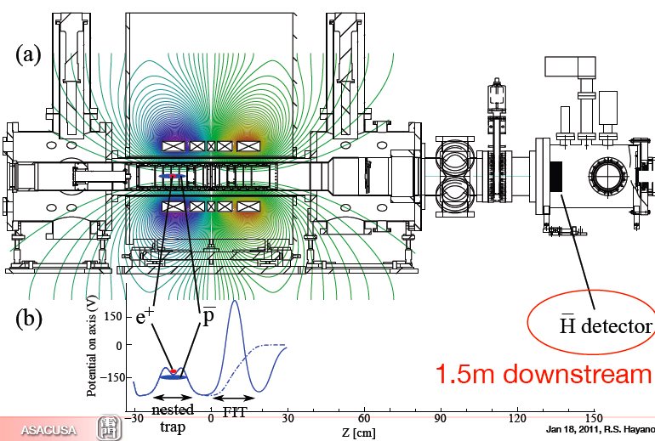
Asacusa trap and detector

Slide 14
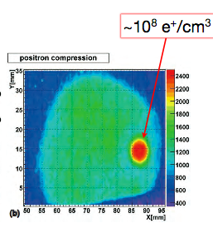
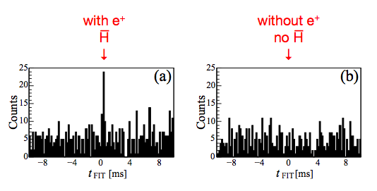
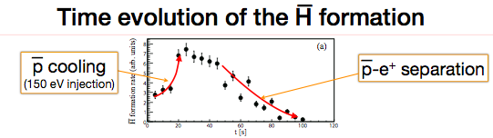

signal from “casp” tarp in Asacusa

Slide 15
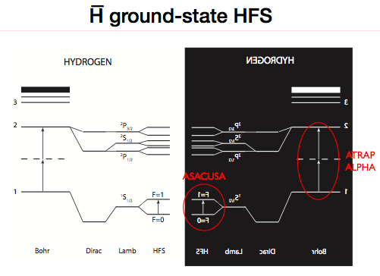
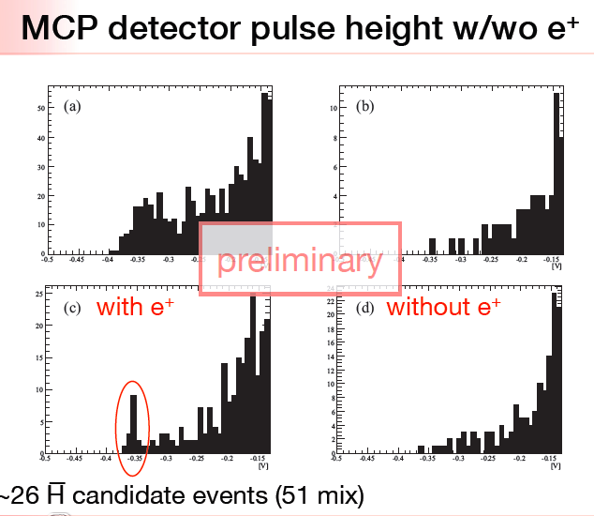
wyprowadzenie anty-wodoru do
zewnetrznego detektora
from R. Hayno – presentation at SPSC Jan.2011

Slide 16
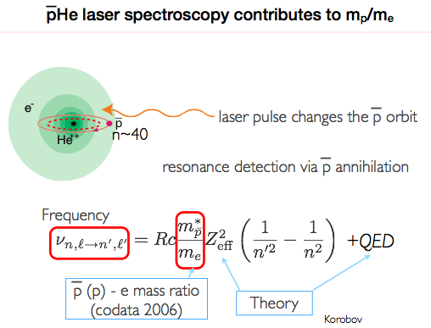
ASACUSA – measurement of antiproton mass

Slide 17
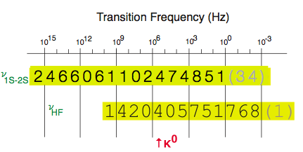
antiproton mass measured almost as precisely as for proton
antiproton
proton
“Imagine measuring the weight of the Eiffel tower - The accuracy we have achieved here is roughly equivalent to making that measurement to within less than the weight of a sparrow perched on top. Next time it will be a feather.”

Slide 18
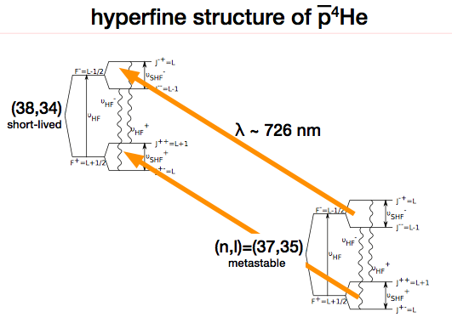
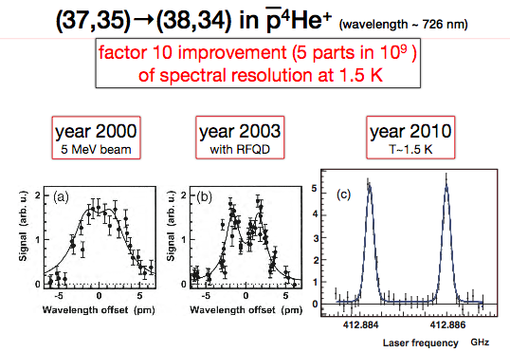
measurement with
double laser beams,
with super cold atoms
→ obtained in 2010
7 states measured in 2010,
next 7 in 2011
“It's the first time that the double-laser technique has been applied
to antiprotonic atoms. Its importance resides in the fact that
the first photon excites the antiproton to an intermediate virtual energy state
(i.e. one that is not allowed by quantum mechanics) while the second photon
completes the transition to the closest real energy state.
Taking advantage of this principle, relatively low-power lasers can be used
to achieve a very high precision in the proton mass measurement,”
explains Masaki Hori, an ASACUSA physicist

Slide 19
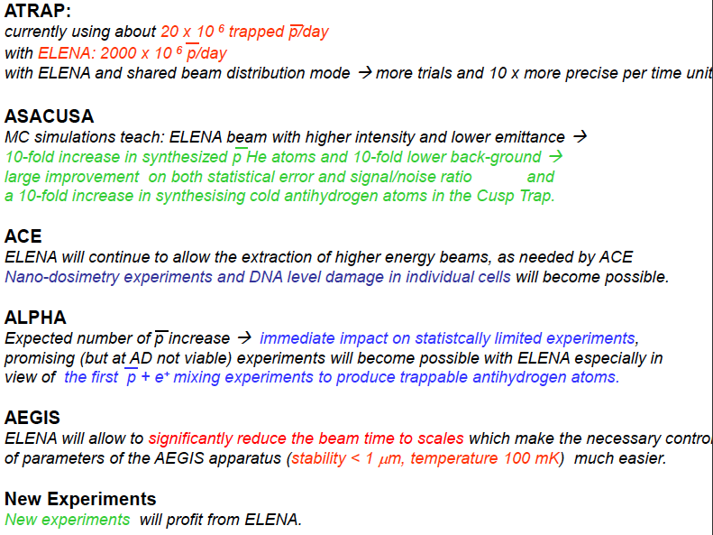
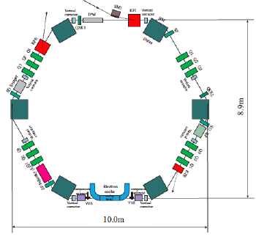
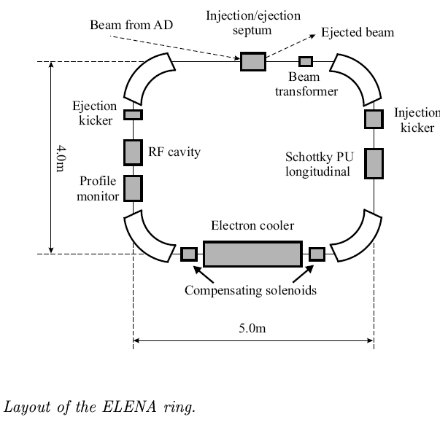
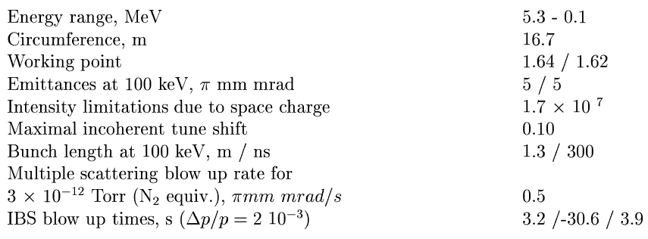
Consequent Future Developments
ELENA@CERN → cooling antiprotons down to 100KeV
→ approved, construction in preparation, should
be done by 2015
ELENA will provide 10-100 times more trapped particles
needed synchronization with FLAIR @ GSI/FAIR (>2015)

Slide 20
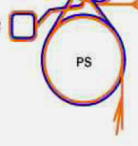
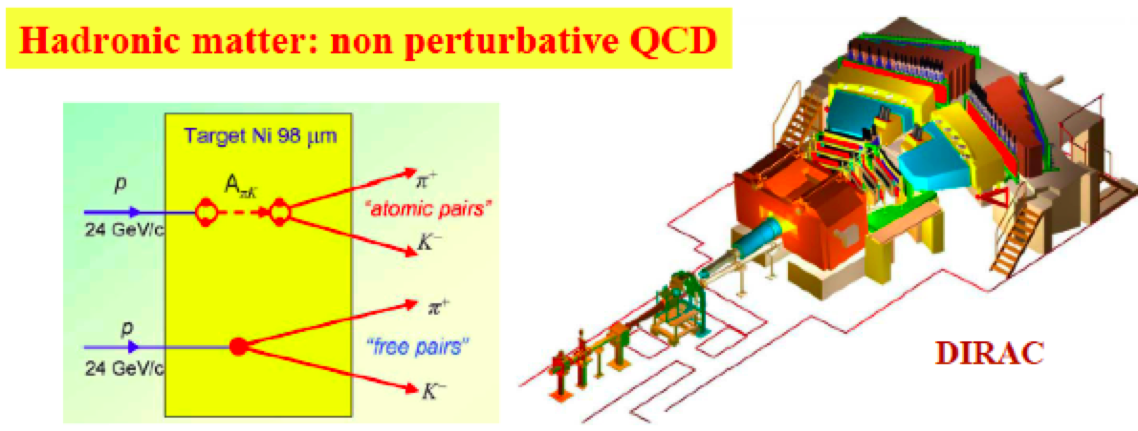
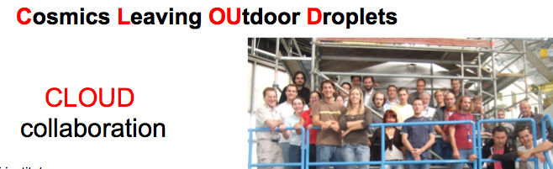
Extracted beams from PS

Slide 21
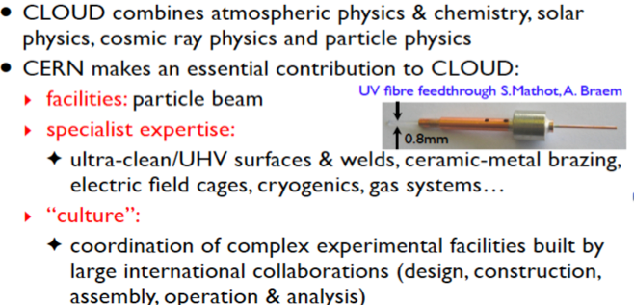
Interdisciplinary research at CERN

Slide 22
A possible mechanism for a link
between galactic cosmic rays and clouds
Solar variability
GCR
Ion concentration
LOSU
High
Nucleation
Medium
Climate variability
Growth
Low
Cloud cover
CCN
LOSU: Level of Scientific Understanding
Notes:
corrlation with cosmic rays, nucleate and eventually go to CCN, FOCUS on the possble microphysical link! (nucleation)

Slide 23
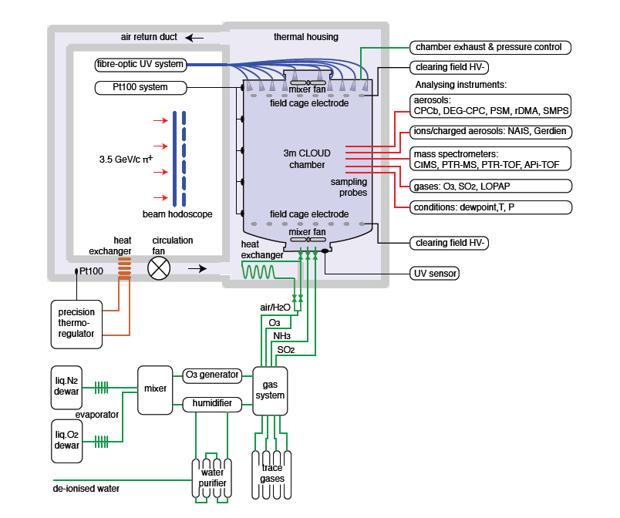
The new CLOUD chamber
T11 PS 3.5 GeV/c π⁺
up to 5000 ion pairs per cm³

Slide 24
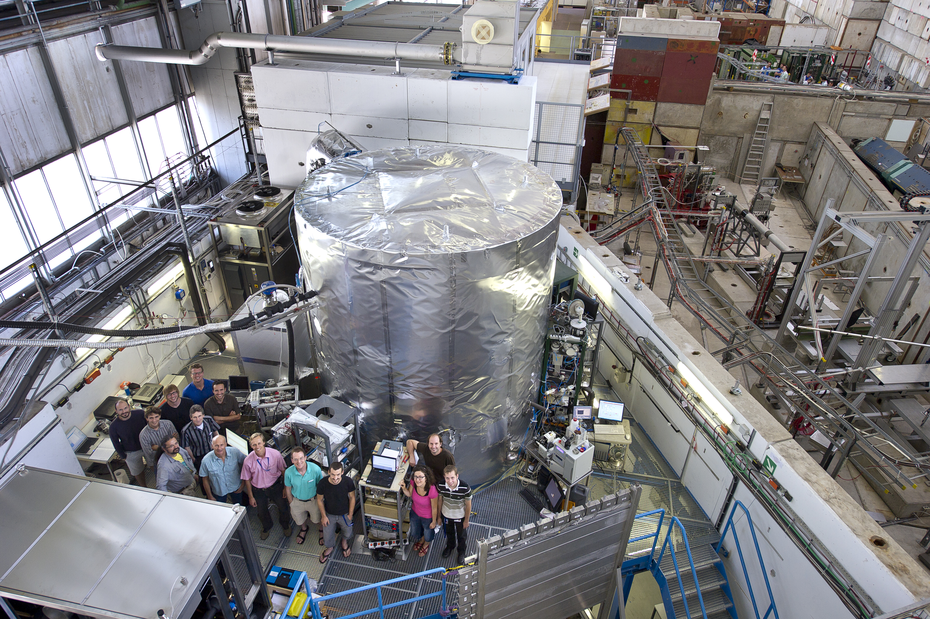

Slide 25
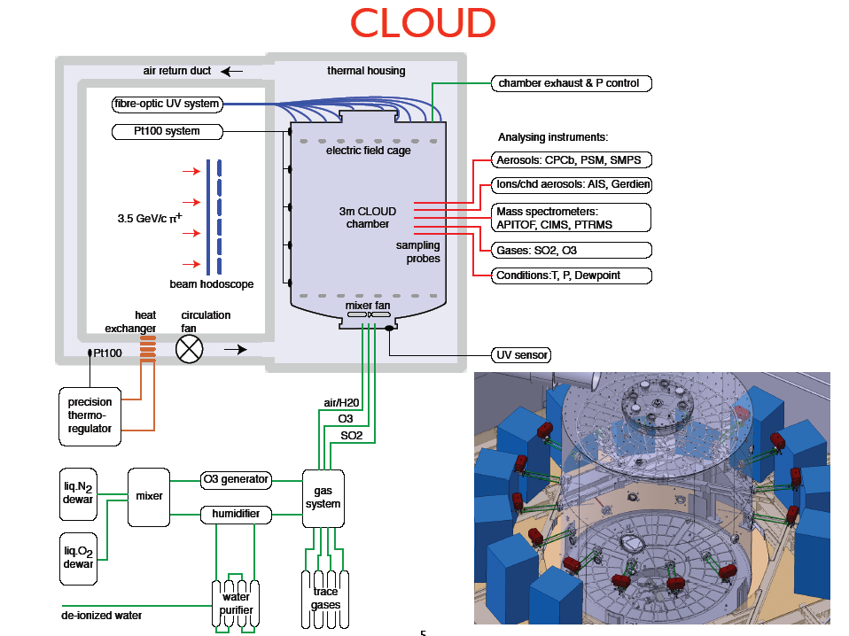
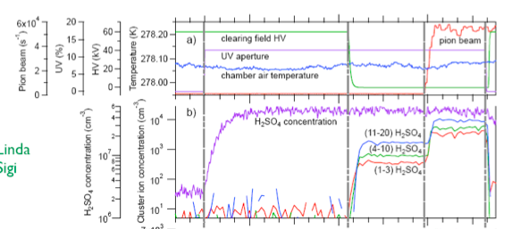

Slide 26
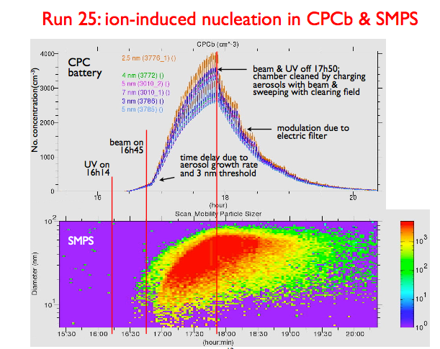
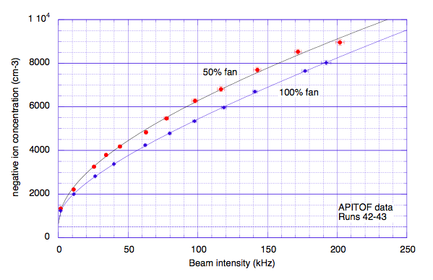
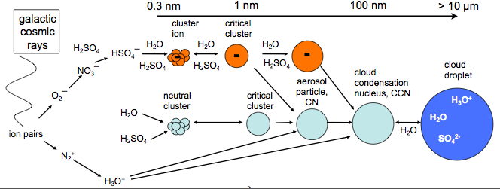
chamber is working and producing
first results:

Slide 27
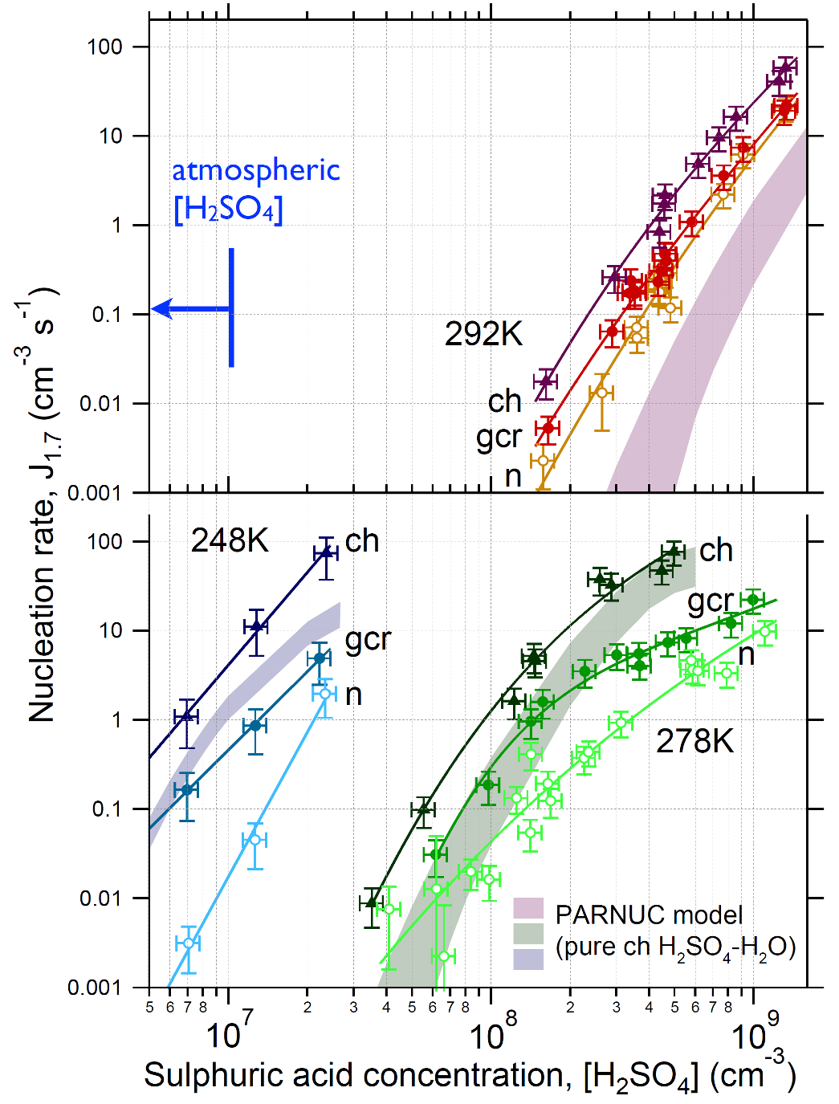
Nucleation rates vs. [H₂SO₄]
With ‚pure‘ sulphuric acid:
Ground level ionisation (GCR) enhances the neutral nucleation rate by a factor of 2 at 298 K
But: Much higher [H₂SO₄] needed than found in the atmosphere
At lower temperature:
lower H₂SO₄ concentrations are sufficient to maintain the same nucleation rates, due to decrease of the H₂SO₄ saturation vapour pressure.
Enhancement by a factor of ~10 by GCR
Kirkby et al., Nature 2011

Slide 28
Comparison to ambient data
Boundary layer nucleation cannot be explained either by binary (H₂SO₄-H₂O) or by ternary nucleation with ammonia
Even with ion enhancement, ternary NH₃-H₂SO₄-H₂O is too low by a factor 10-1000
Kirkby et al., Nature 2011
Notes:
Boundary layer nucleation cannot be explained either by binary (H2SO4-H2O) or by ternary nucleation with ammonia
Even with ion enhancement, ternary NH3-H2SO4-H2O is too low by a factor 10-1000

Slide 29


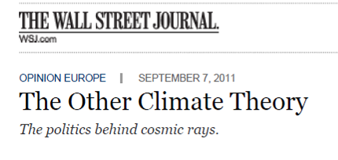

Very high public interest
UPI.com

Slide 30
plans with CLOUD

Slide 31


CAST experiment @ CERN using LHC prototype magnet
non accelerator experiment
Axions: hypothetical particle solving the strong-CP problem of QCD
Very well motivated candidate for the Dark Matter
Produced copiously in the Sun
Axion helioscope concept (Sikivie, 83)
  Axions convert back into photons in a strong transverse B field
CAST is the most powerful implementation of an axion helioscope
  CAST phase II: inserting gas (⁴He, ³He) inside the magnet bores to gain sensitivity to high axion masses
X-ray detectors
(+ x-ray focusing optics)
X-ray detectors
LHC test magnet
9 T, 10 m
Platform to track the Sun (±8°V ±40°H)
3 h/day)

Slide 32


Latest CAST results: first ³He data
Results from first ³He (2008) data (red line).
Masses 0.39 – 0.65 eV excluded down to 2-2.5 x 10⁻¹⁰ GeV⁻¹
Touching KSVZ benchmark models for the first time
He3 data up to 1.15 eV taken, being analyzed.
Preprint just released:
S. Aune et al. (CAST collaboration) arXiv:1106.3919v1

Slide 33


A New Generation Axion Helioscope
Feasibility study ongoing for a completely new setup.
Goal: 1-1.5 orders of magnitude in sensitivity to g_{aγ} better than CAST
First feasibility results and sensitivity prospects recently published:
I G Irastorza et al., JCAP 1106:013,2011 (arxiv:1103.5334)
New larger toroidal magnet –
specifically built for axion physics
All bores equiped with x-ray focusing and low b detectors
-
Fully exploiting innovations of CAST
Each conversion bore (between coils) about 0.5-1 m diameter
Conceptual view of the NGAH

Slide 34
and finally the highest energies:
extracted protons
production of
secondary beams
North
Area
secondary beams
→ studies of nucleon structure
ion collisions
rare K decyas

Slide 35

Compass – SPS – muon and hadron beams
hadron structure physics tries:
  to understand the phenomenology resulting from QCD
  provide input for searches for New Physics
improvements in precision and
kinematic coverage for parton
distributions is still needed
  COMPASS
  → results on gluon polarization
  → hadron spectroscopy
  → short, medium and long term plans:
    spin structure,
    GPD,
    D-Y on pol. nucleon
    exotic states,
    central production

Slide 36


NA61 - SPS (light) ion program
Hadronic matter
→ deconfinement
search for critical point, understanding of phase transition
SPS gives an unique possibility for a scan in energy and atomic number of projectile and targe
light secondary ions in parallel with Pb for LHC, primary argon (?)
also taking data for hadro-production on T2K target and pA, πA for cosmic rays

Slide 37


NA62 - SPS - looking for new physics
experiment in construction phase, technical run 2012

Slide 38







Kinematic Selection: Cuts on M²_{miss}
π⁺νν
R1
R2
π⁺π⁰
μ⁺ ν
π⁺π⁺π⁻

Slide 39

Preparation for the K⁺→ π⁺νν Analysis
Kinematic rejection
Charged particle rejection
Photon rejection
π/μ separation and μ suppression
General Theme: Maintain a good
signal/background ratio
preserving the signal acceptance
as much as possible
Missing Mass Resolution

Slide 40



Beam Line & Infrastructure
A very significant achievement was the completion of the new beam dump
The beam line is being installed
The tendering process for the vacuum system is in progress
The surface building is being refurbished
The contribution of the EN/MEF team is invaluable

Slide 41


NA62 Detector
NA62 / 2012 Layout
SAC
CHOD
CEDAR
≈50% equipped
CHANTI
Prototype
Temp. Beam Pipe
LKr
SLM readout
+ CREAM
Prototype ?
MUV
2+3
½ Straw
Chamber
8 LAV, 3 with Readout
NA62 / 2014 Layout
SAC
CHOD
Target
CHANTI
CEDAR
GTK
Beam Pipe
RICH
LKr
MUV
Straw
Tracker
IRC

Slide 42
K⁺→ π⁺νν: Analysis Summary & Plans
During the past year Several effects have been studied
Kinematic rejection
  Effect of the non gaussian tails
  Beam pileup
Multi-charged particle background
  Use of the veto detectors
  Spot and cure possible flaws of the layout
Photon veto:
  Effect of the detector material on the photon detection efficiency
Muon-ID using the calorimeters.
The most important backgrounds are in line with our expectations and the signal acceptance
is kept at abut 10%.
In 2012 the reparation to the K⁺→π⁺νν will continue.
Better definition of the multiplcity cuts.
Effect of the material on the detection of the photons in the LAVs. Study of the possibility to measure the photon detection inefficiency using data (as it has been done for the LKr).
Further progress in the muon identification using the calorimeters.
Assessment of background level from:
  K⁺→ π⁺π⁰(γ)
  K⁺ → π⁺π⁺π⁻
  K⁺ → μ⁺ν(γ)
  K⁺ → π⁺π⁻e⁺(μ⁺)ν
  Beam induced background

Slide 43




K_{e2} and K_{μ2} samples
K_{e2} candidates
K_{μ2} candidates
Log scale
Background source | B/(S+B)
K_{μ2} | (5.64±0.20)%
K_{μ2} (μ→e) | (0.26±0.03)%
K_{e2γ} (SD⁺) | (2.60±0.11)%
K_{e3(D)} | (0.18±0.09)%
K_{2π(D)} | (0.12±0.06)%
Wrong sign K | (0.04±0.02)%
Muon halo | (2.11±0.09)%
Total | (10.95±0.27)%
145,958 K±→e±ν candidates.
Electron ID efficiency: (99.28±0.05)%.

Slide 44


The result (full NA62 data set)
R_{K}=K_{e2}/K_{μ2}
R_{K} = (2.488 ± 0.007_{stat} ± 0.007_{syst}) × 10^{–5}
R_{K} = (2.488 ± 0.010) × 10^{–5}
Fit over 40 measurements (4 data samples × 10 momentum bins)
including correlations: χ²/ndf=47/39.
Uncertainty source | δR_{K}×10⁵
Statistical | 0.007
K_{μ2} background | 0.004
K±→e±νγ (SD⁺) | 0.002
K±→π⁰e±ν, K±→π±π⁰ | 0.003
Beam halo background | 0.002
Thickness of spectrom. | 0.003
Acceptance correction | 0.002
DCH alignment | 0.001
Electron identification | 0.001
1TRK trigger efficiency | 0.001
LKr readout efficiency | 0.001
Total uncertainty | 0.010
R_{K} vs lepton momentum
R_{K} vs data sample
Partial (40%) data set: PLB 698 (2011) 105.
Full data set: paper to be submitted in April/May 2012.

Slide 45

Beam from CERN, experiments close to Rome – neutrino beam
neutrino
oscillation search
OPERA
ICARUS
730 km, Gran Sasso Laboratory
nie bedzie o pomiarze predkości neutrin

Slide 46



underground Gran Sasso laboratory
around 5 in 2011

Slide 47



OPERA detector
range of τ >100μm
Plastic base
hybrid detector:
  spectrometer to localize interesting
candidates for τ production
  emulsion target and tracker
1 mm
τ
ν
Pb
Emulsion layers
200 tys bricks:
56 emulsion films / brick

Slide 48


candidte

Slide 49


Slide 50


several improvements in data analysis and background estimations, example:
present expectations:

Slide 51


other event topologies:

Slide 52

The ICARUS detector in underground Hall B of LNGS

Slide 53


LAr purity time evolution and trigger
Offset value (2.40 ms)
in agreement with ν t.o.f.
(2.44 ms) with the addition
of 40 μs fiber transit time
from external LNGS labs
to Hall B (8km).

Slide 54
Preliminary results of first CNGS 2010 run
Full sample analyzed, i.e. 5.8 ⋅ 10¹⁸ pot. Classified by visual scanning into fiducial volume of 434 t.
Number of collected interactions compared with number of interactions predicted ((2.6 ν CC + 0.86 ν NC) 10⁻¹⁷/pot), in the whole energy range up to 100 GeV, corrected by fiducial volume and DAQ dead-time.
Event type | Collected | Expected
ν_{μ} CC | 115 | 129
ν NC | 46 | 42
ν XC * | 7 | -
Total | 169 | 172
* Events at edges, with μ track too short to be visually recognized: further analysis needed.
On overall statistics in agreement with expectations.

Slide 55


Reconstructed CC events in T600
e⁻, 15 GeV, p_{T}=1.16 GeV/c
120 cm
CNGS νe interaction, E_{ν}=16.6 GeV
Vertex: 1π⁰,2p,3n,2 γ,1e⁻
290 cm
CNGS νμ interaction, E_{ν}=21.3 GeV
80 cm
Vertex: 3π,5p,9n,3γ,1μ
300 cm

Slide 56


Run 9392 Event 106
3D
2: π → μ → e
Z
Y
X
Track 1 (prob. π, decays in flight) 2 (π) 2a (μ) 2b (e) 3 (μ) 4 (p) 5 (p) 6 (?) (merged with vtx) | E_{k} [MeV] 136.1 26 79.1 24.1 231.6 168 152 | Range [cm] 55.77 3.3 17.8 10.4 99.1 19.2 16.3 2.9
Total deposited energy: 887 MeV
Total reconstructed momentum:
929 MeV/c at about 35° away from the CNGS beam direction

Slide 57
Summary
reach “non-LHC” program at CERN is doing well
since last year it brought several “press release” news:
  anihydrogen trapping
  first observation of a neutrino interaction after flavour change
  antiproton mass high precision measurement
plans for new experiments are welcomed and coming
  as a result of dedicated “Diversity workshop” in 2009
  as a natural continuation of the existing programs
  new ideas
this is an important component of the laboratory health
it is expected to continue evolving with required support to complement high energy frontier research

Slide 58






!
CERN is awaiting interesting results
from LHC, but not only form it ...
CMS
LHCb
ALICE
LHC ring:
27 km circumference
ATLAS

